Slide 1


Apache Kafka & Apache Spark
Programming Integration Project - Data Engineering
Students:
Trần Tuấn Kiệt
Phạm Duy Tường Phước
Phan Hồng Quân
Instructors:
Assoc.Prof. Thoại Nam
La Quốc Nhựt Huân
Đinh Phúc Hưng

Slide 2

TABLE OF CONTENTS
Apache Kafka
Apache Spark

Slide 3
APACHE KAFKA
Introduction to Apache Kafka and Kafka Streams
KStream ETL Functions
Custom Aggregation
Demonstrations

Slide 4

1. Introduction to Apache Kafka and Kafka Streams API
What is Apache Kafka
What is Kafka Streams

Slide 5
Apache Kafka

Slide 6
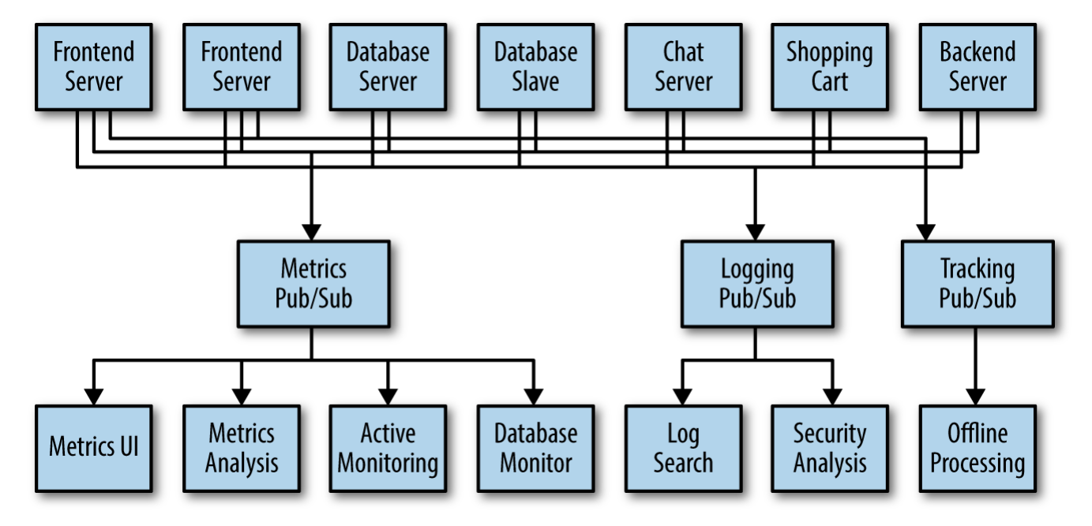

Slide 7
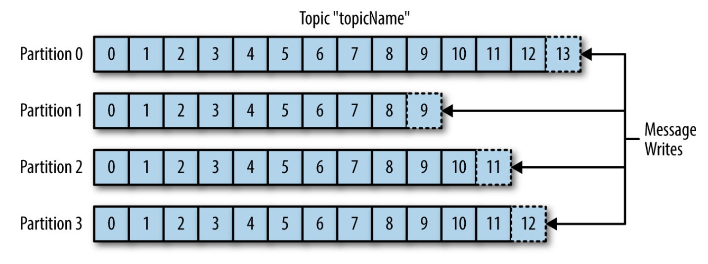

Slide 8
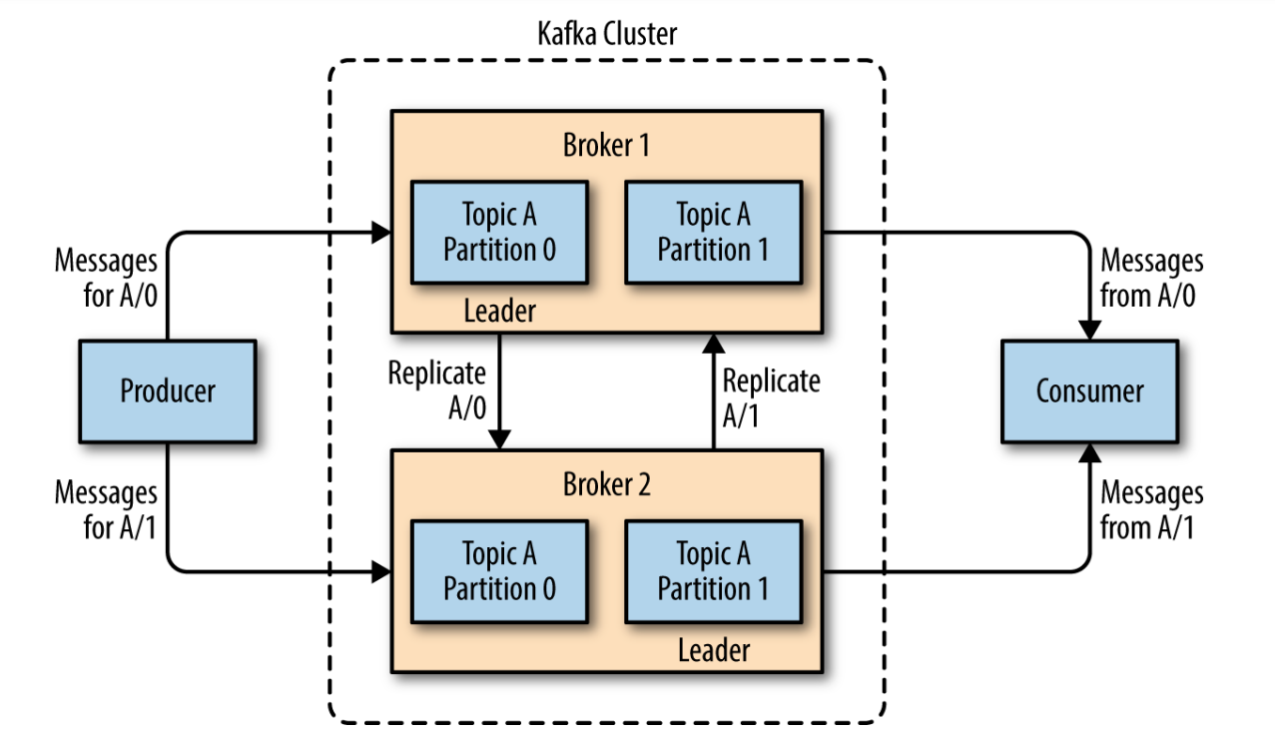

Slide 9
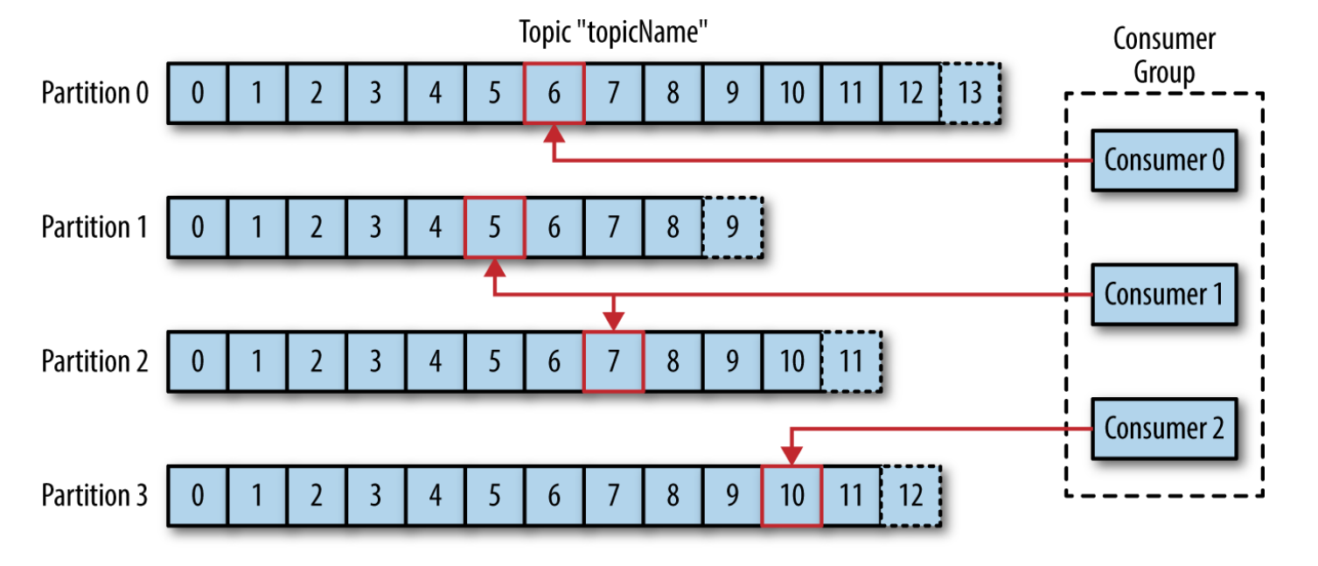

Slide 10
Kafka Streams API

Slide 11
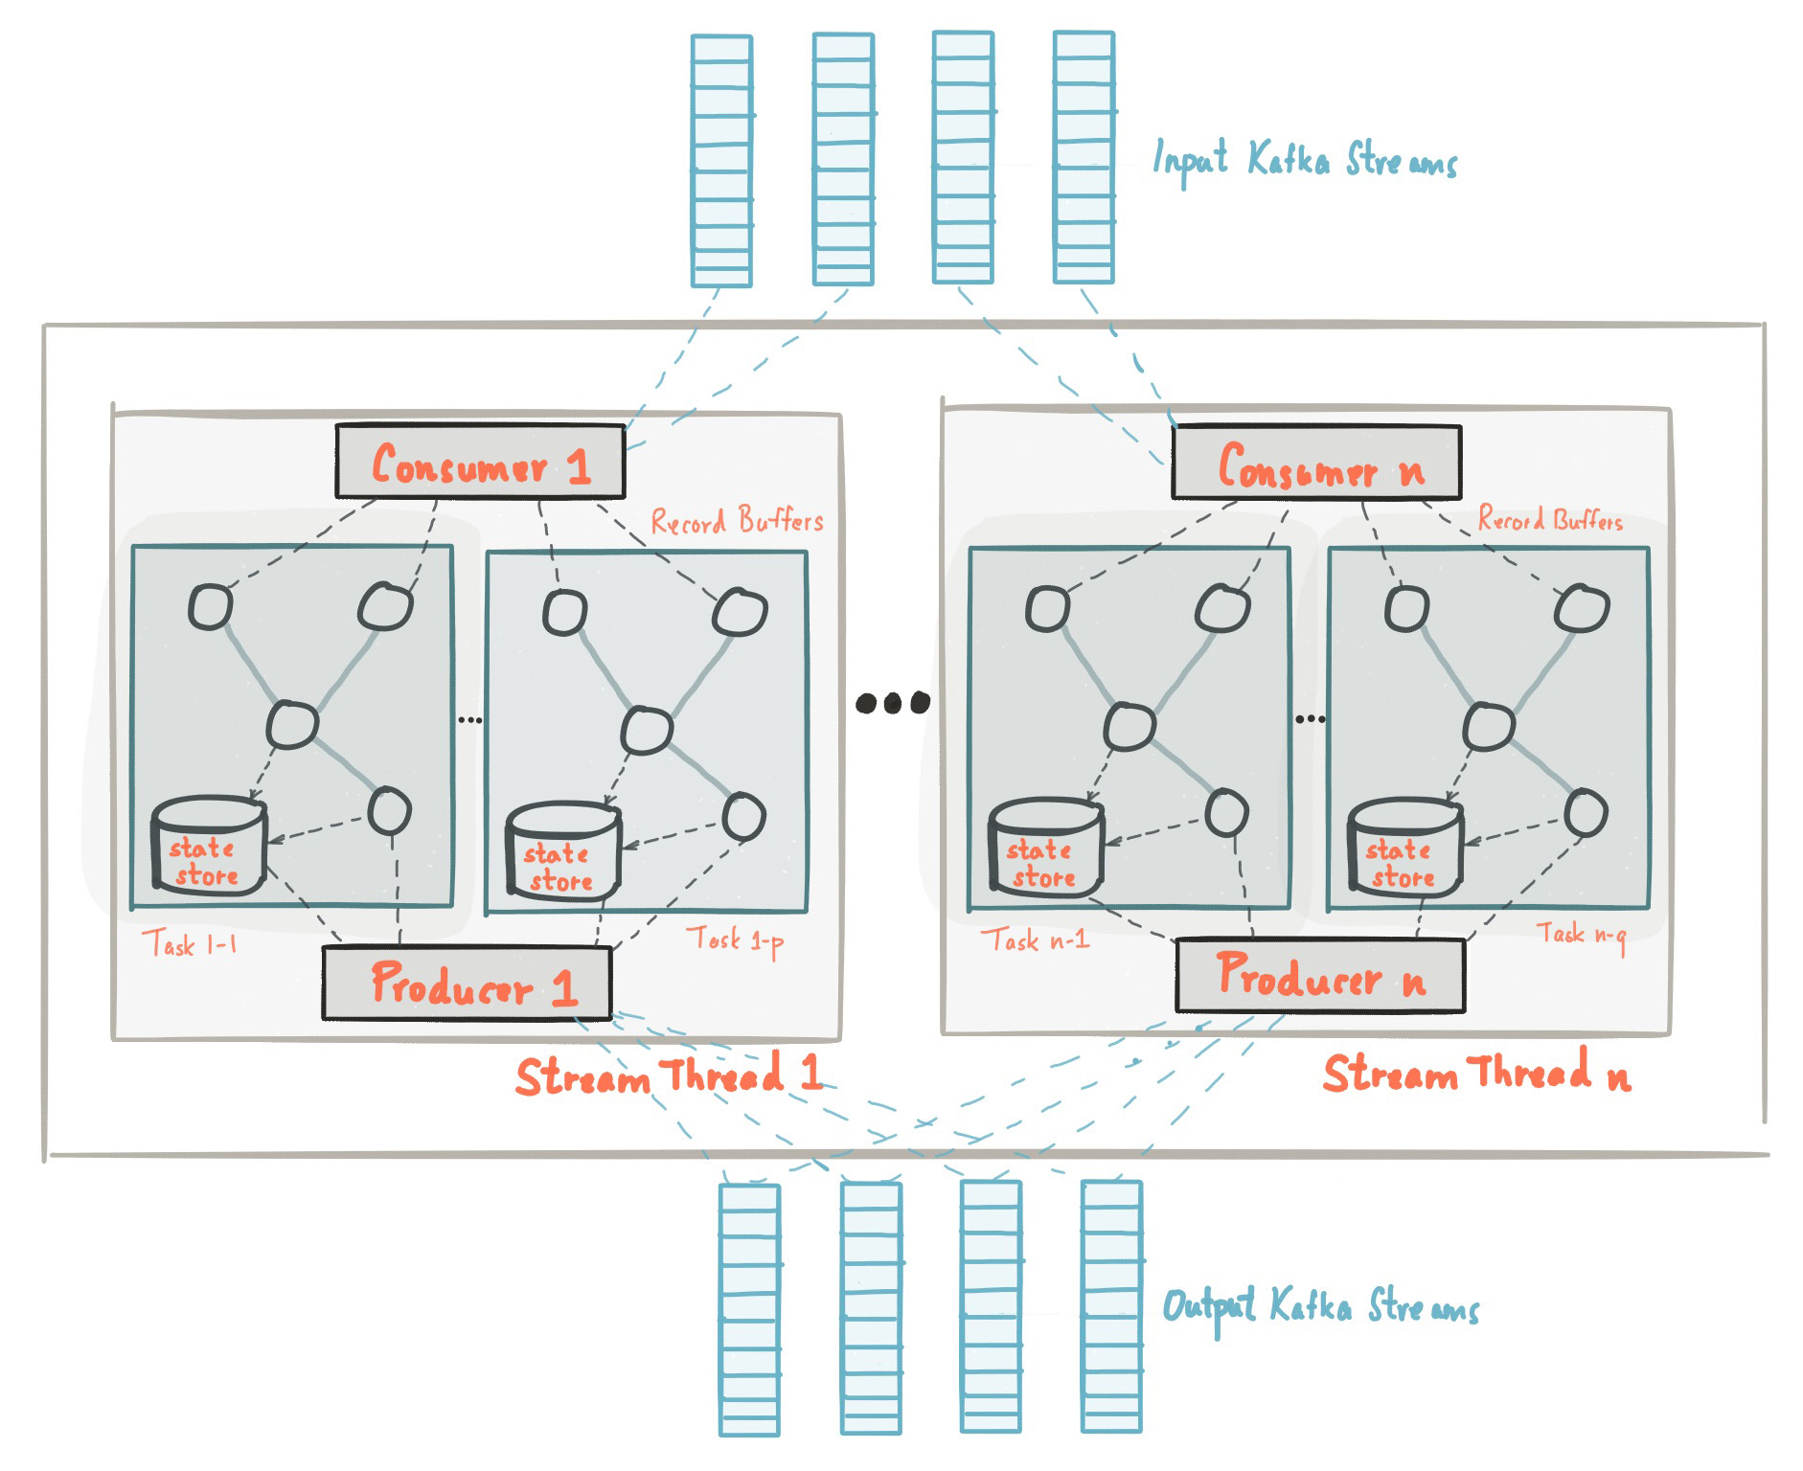

Slide 12
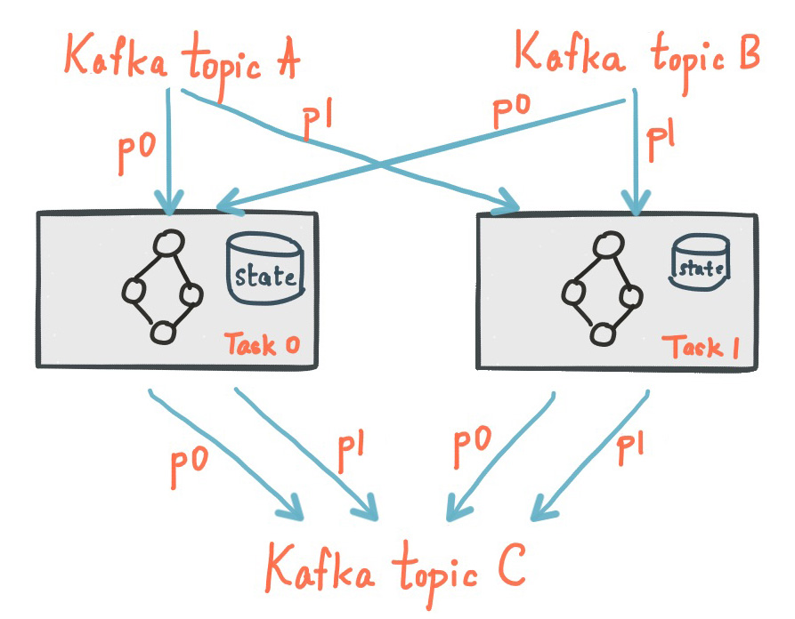

Slide 13
KStream & Its ETL Functions
KStream is an abstraction of a record stream of KeyValue pairs, i.e., each record is an independent entity/event in the real world.

Slide 14
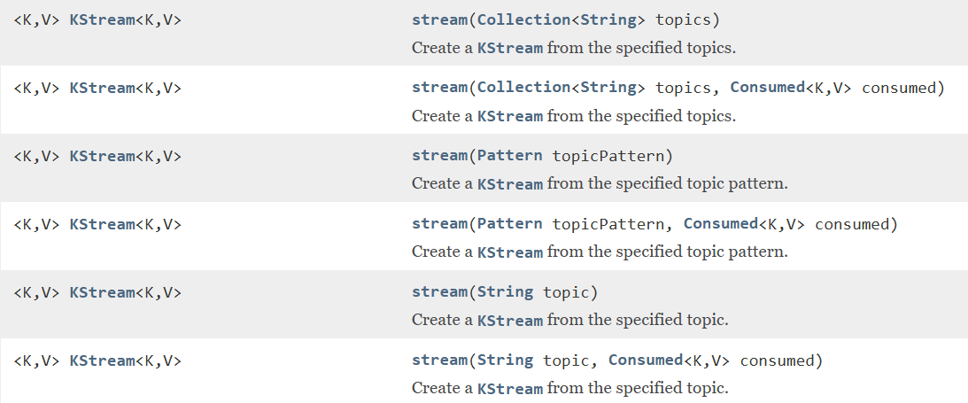
KStream Constructor

Slide 15
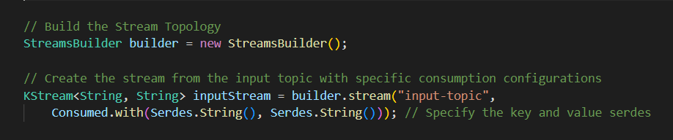
KStream Constructor

Slide 16
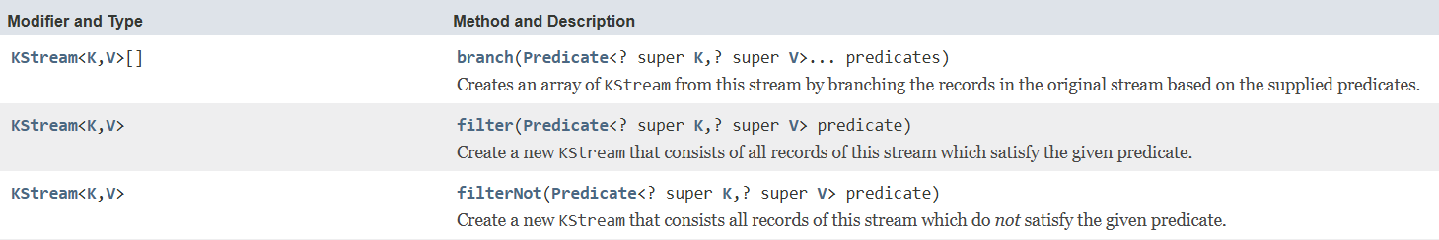
Extract Functions

Slide 17
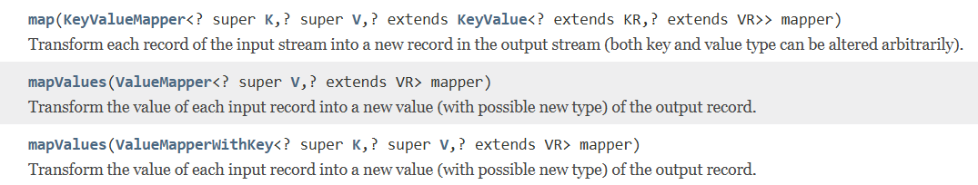
Transform Functions

Slide 18
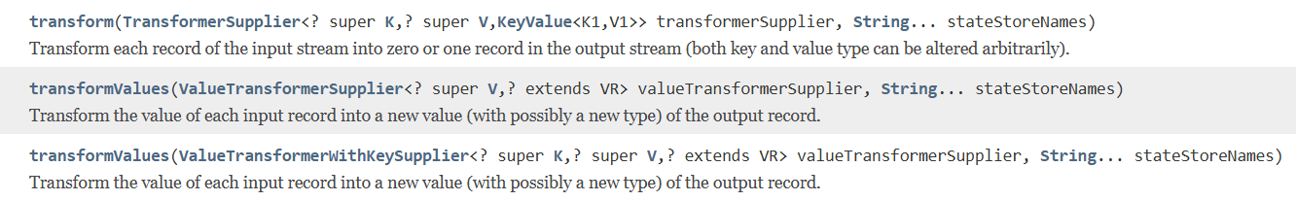
Transform Functions

Slide 19
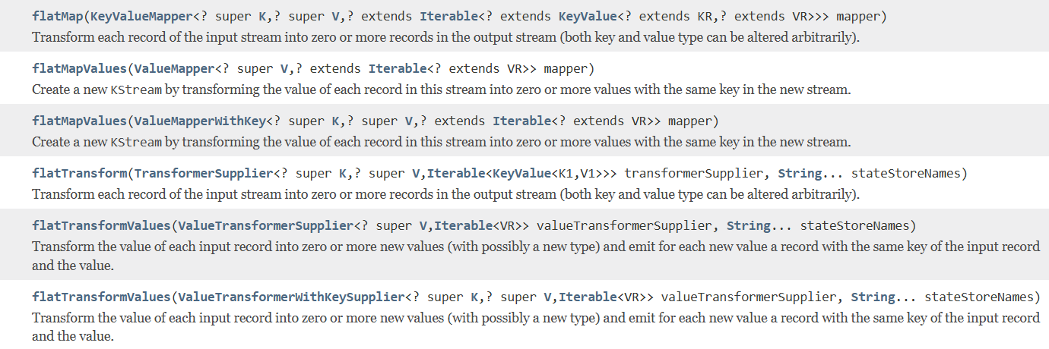
Transform Functions

Slide 20
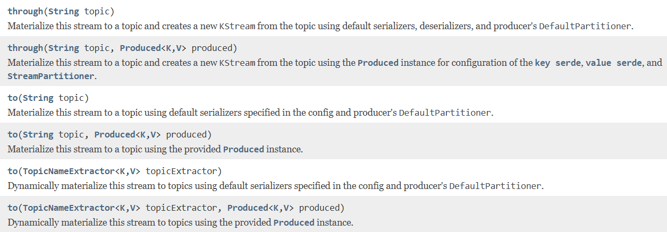
Load Functions

Slide 21
KStream Custom Aggregation

Slide 22
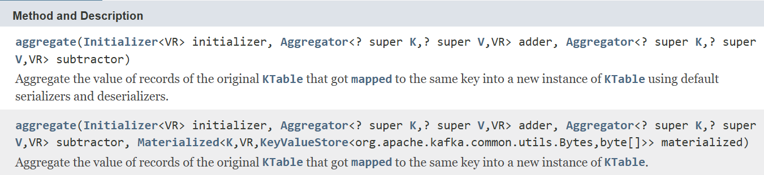
KGroupedTable aggregate()

Slide 23
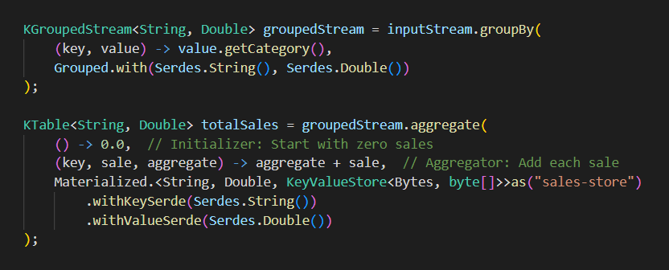
Customize aggregate()

Slide 24
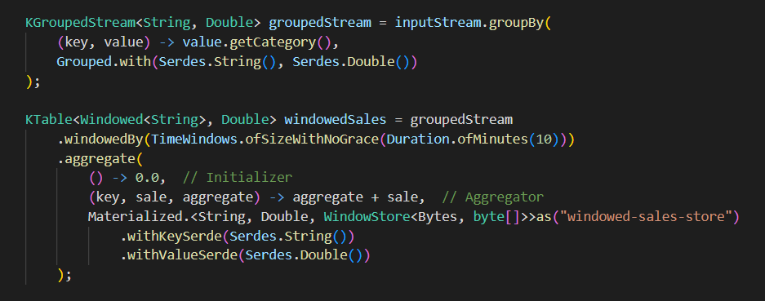
Aggregation with windows

Slide 25
Demonstration

Slide 26
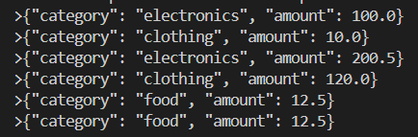
Scenario
Input: A stream of sales records with fields for category, and amount.
Processing: Group records by category and calculate the total sales for each category.
Output: The aggregated results are written to an output topic.

Slide 27
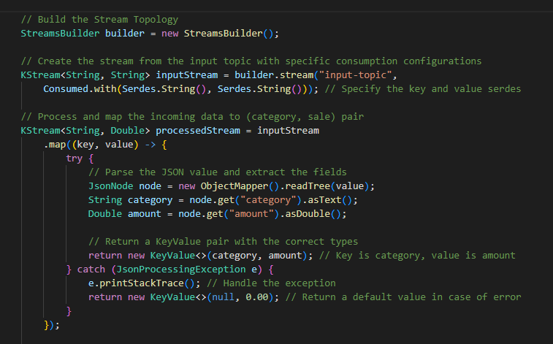

Slide 28
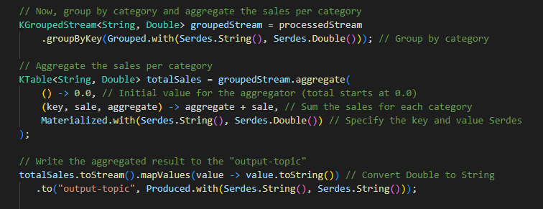

Slide 29
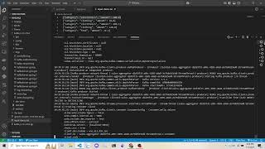
Demonstration

Slide 30
APACHE SPARK
Principle of RDD, DataFrame
Apache Spark Module
Demonstration

Slide 31
1. Principle of RDD, DataFrame

Slide 32
RDD (Definition)
RDD (Resilient Distributed Dataset) - a foundation data structure in Spark
Resilient: Fault-tolerant, capable of rebuilding data in case of failure
Distributed: Data is partitioned and distributed across multiple nodes in a cluster
Immutable: New RDD is created for any changes made on the RDD instead of really changing the current RDD

Slide 33
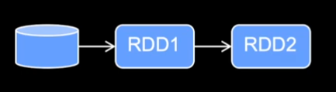
Immutable of the RDD

Slide 34
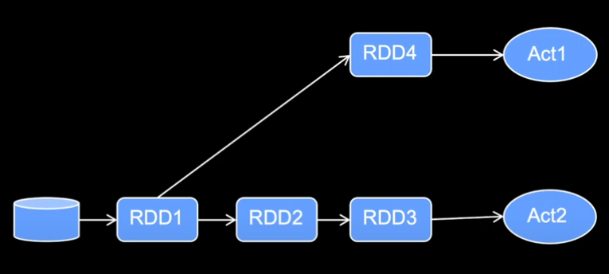
Principle of RDD
Continuous executing change on RDD would be inefficient because of many time reading dataset and not optimized execution order

Slide 35
Principle of RDD
Directed Acyclic Graph (DAG): Instead of applying changes on RDD, Spark would just store the plan for executing the plan in the DAG. Only when an action is triggered, the plan in DAG is executed.
→ One-time-reading dataset and optimized execution plan.
Operations on RDD:
Transformations: used to create new RDDs. Ex: map, filter, flatMap
Narrow transformation: one-to-one mapping, a partition from child RDD is constructed from at most one partition from parent RDD
Wide transformation: many-to-one mapping, a partition from child RDD may be constructed from many partitions from parent RDD
Actions: trigger computations on RDDs and send the result to the driver program. Ex: collect, count,..

Slide 36
Principle of RDD
Low-level APIs: although allow close control on the dataset, it makes the code cumbersome.
No schema required: make data inconsistent sometimes in processing state and lack of more sophisticated optimization

Slide 37
DataFrame (Definition)
A high-level abstraction built on top of RDDs (Resilient Distributed Datasets).
A structured, table-like format with named columns and defined data types resembling SQL tables. It does require schema.
High-level API for data manipulation and working with structured data
Catalyst Optimizer: enhances the performance of queries executed on DataFrames and Datasets

Slide 38
Context | RDD | Dataframe | Dataset
Data representation | Distributed collection of data elements without any schema | Distributed collection organized into named columns | Extension of DataFrames with type safety and object-oriented interface
Type safety | No type-safe | Offer run-time type-safe | Compile-time type checking
APIs | Low-level API that requires more code to perform transformations and actions on data | Provide a high-level API that makes it easier to perform transformations and actions on data | Support both functional and object-oriented programming paradigms and provide a more expressive API for working with data
Schema enforcement | Do not require a schema | Enforce schema at runtime | Enforce schema at compile time.
Optimization | No inbuilt optimization | Catalyst optimizer | Catalyst optimizer
Programming language support | Java, Scala, Python and R | Java, Scala, Python and R | Scala and Java

Slide 39
2. Apache Spark Module

Slide 40
Modules
Core Module
SQL Module (Spark SQL)
Streaming Module (Structured Streaming)
Machine Learning Module (MLLib)
Graph Processing Module (GraphX)

Slide 41
3. Demonstration
Component: Performance, SparkSQL, MLLib, GraphX

Slide 42
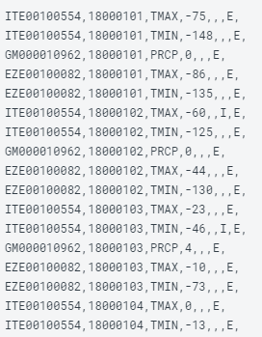
Spark SQL
Description: Temperature information
Dataset: 1800 rows, 7 columns
File format: CSV

Slide 43
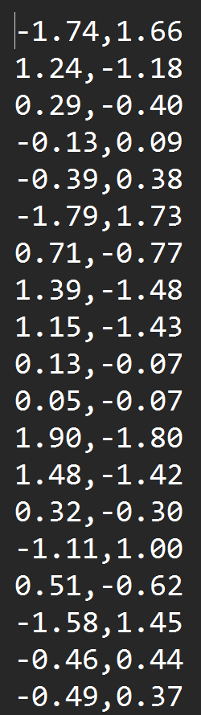
MLLib
Target: Predict the value using Linear Regression
Dataset: 1000 rows, 2 columns
File format: txt

Slide 44
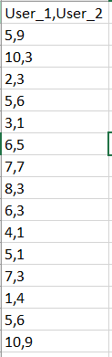
GraphX
Target: Find mutual friends between users
Dataset: 200 rows, 2 columns
File format: csv

Slide 45
THANK YOU FOR YOUR ATTENTION

